Slide 1

Code Refactoring
And Bug fixing
A.Bharath Kumar IN1240657

Slide 2
Technologies used
Html
Python
Flask

Slide 3
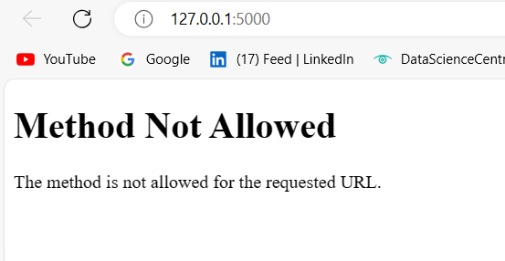
Task to do
Fix the bugs from front end html to back end python and Flask
Bugs
Bug 1

Slide 4
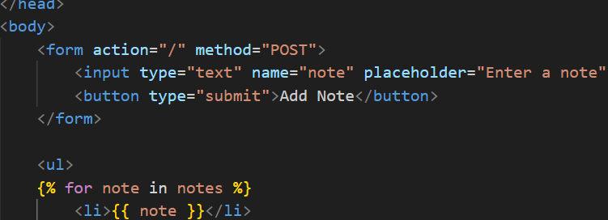
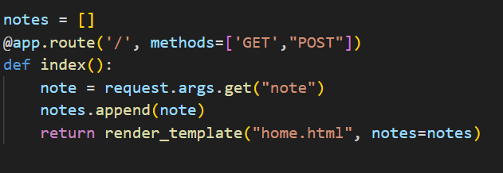
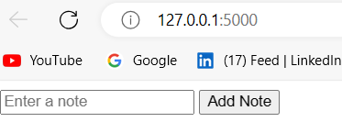
Solved
By adding post method to html form and action ‘/’ and GET in app.py

Slide 5
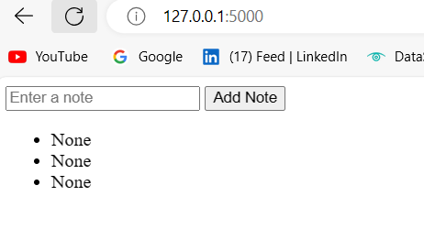
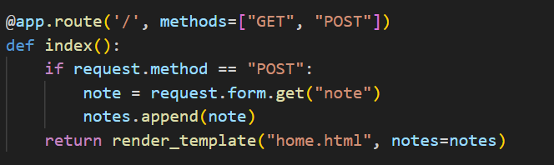
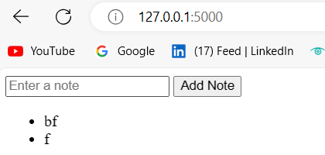
Bug 2
Not able to add note
Solved

Slide 6
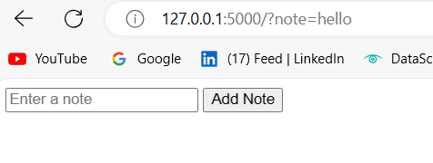
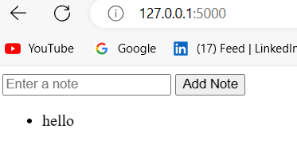
Bug 3
Getting parameters in the url
Solved
Getting parameters in the url

Slide 7
Thank you

